Slide 1
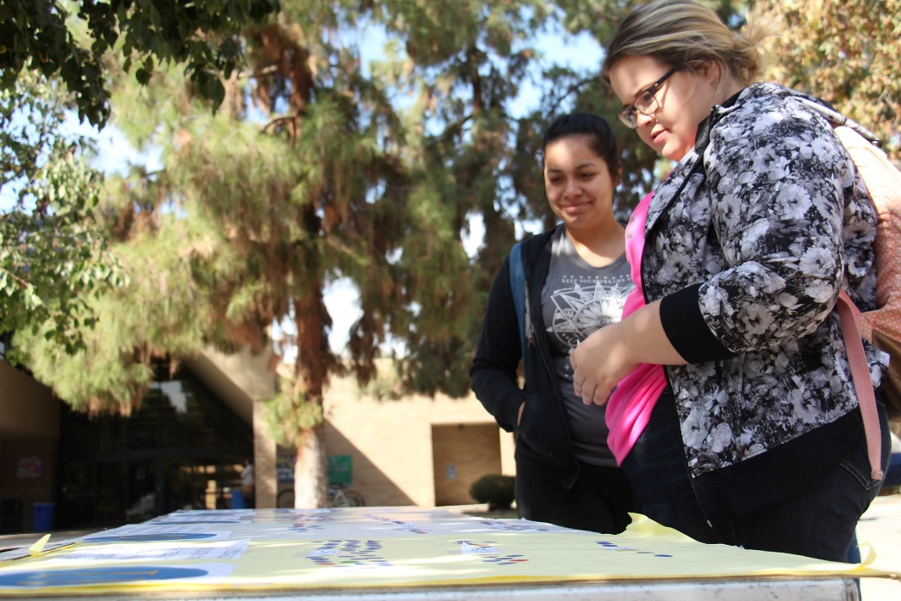

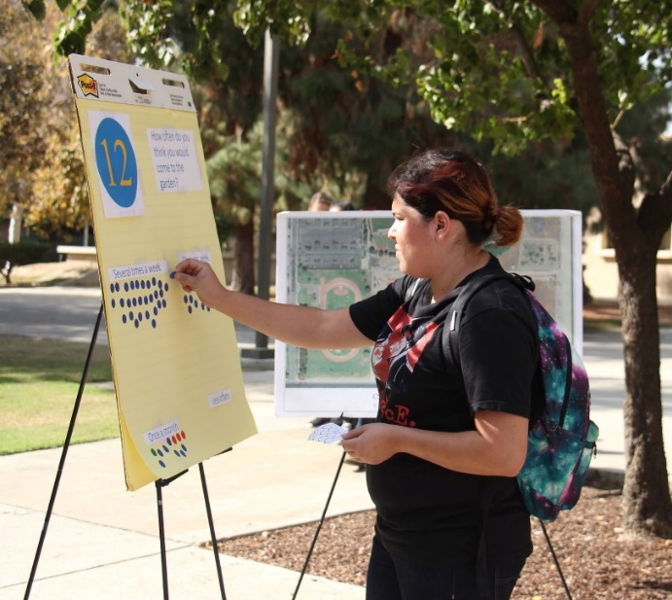
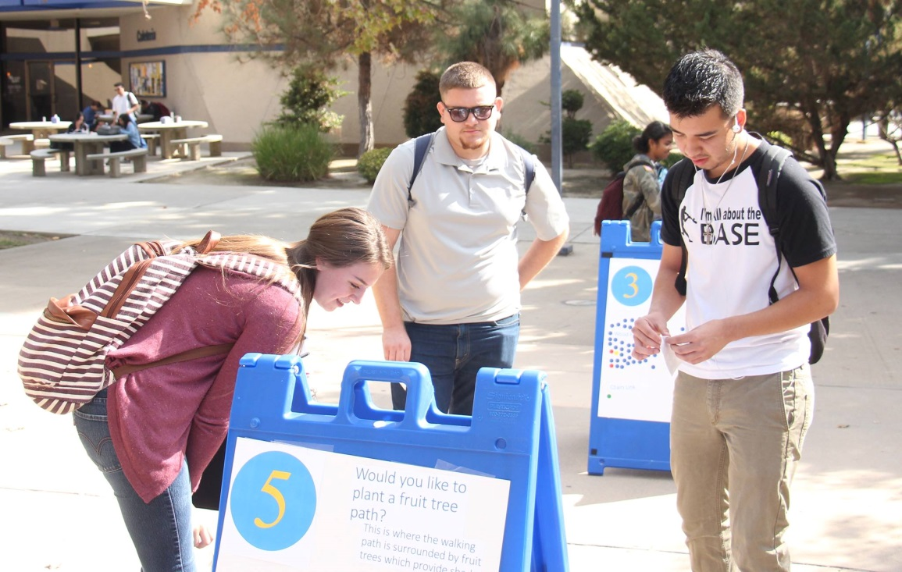
Edible Garden
Charrette Results
October 2016
Photos by The Runner

Slide 2
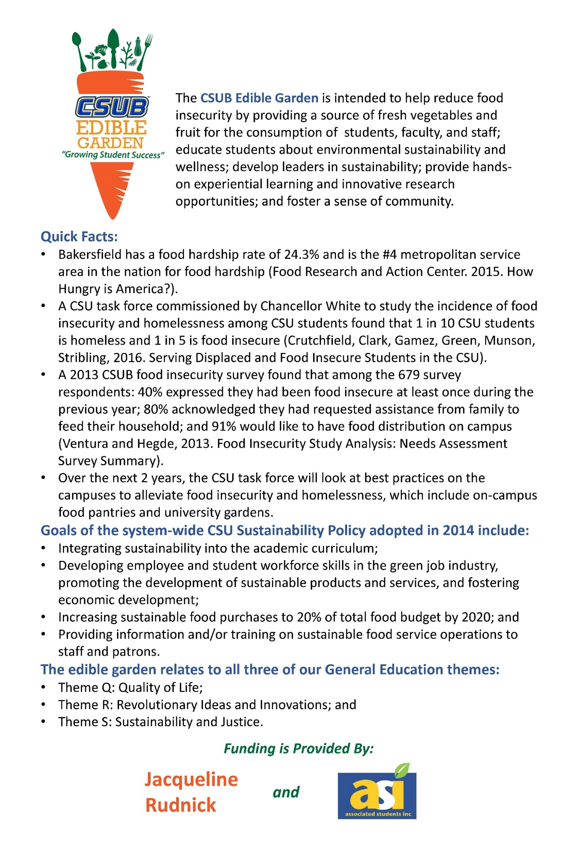

Slide 3
On October 12th-18th, 2016 California State University, Bakersfield organized a campus-wide charrette to seek opinions and feedback on the proposed Edible Garden features from students, staff, and faculty.
Results
The charrette was hosted in person and provided digitally. In total, more than 550 participants provided their opinions and ideas for the Edible Garden. Although community member opinions were not solicited, they were not turned away.
A charrette is a public meeting or workshop devoted to a concerted effort to solve a problem or plan the design of something (Oxford University Press, 2016).

